Slide 1
Computational Thinking
Chapter 3
LECTURE NOTES
QALBEEN KHALID

Slide 2
Programming
Programming is writing computer code to create a program, to solve a problem.

Slide 3
Programming Language
·A programming language is a set of instructions and syntax used to create programs. Some examples of programming languages are python, Java, C++.

Slide 4
Syntax
·Syntax is specific rules and structure used to write code in a specific programming language.

Slide 5
BASIC DIFFERENCE
Command: A single instruction given to the computer
Program: A set of instructions given to the computer
Algorithm:A plan to solve a problem Steps to solve a problem

Slide 6
Basics of Programming Language
Variables
A variable is a value that can change. variables have 2 parts a variable name and a value. The name of the variable should be relevant to what value it is holding. To give a value to a variable we use the =.

Slide 7
Constant
A value that does not change. A fixed value

Slide 8
Data Types
Data types is the type of value that can be stored in a program. There are 3 main data types strings (text), integer (whole number) float (decimal).

Slide 9
Operators
Operators are symbols used to perform operations on values, such as addition, subtraction, and comparison. Add + Subtract - Multiply * Divide /

Slide 10
Step 1: Program Requirement
The first step before creating an application is getting program requirements. The program requirement is what the user wants from a program. What functionality should it provide

Slide 11
Step 2: Creating Algorithms
It is created in the English language. An algorithm has two main keywords input and output. Each program will be divided into inputs and outputs. With the inputs we can perform arithmetic operations using any operator.

Slide 12
PROGRAM REQUIREMENTS
Input email and password and output “account created”
Input a number, multiply it by 10, add 20 and display the answer.

Slide 13
Algorithm Questions
User enters their name display “hello” and user’s name.
User gives a number add 54 to it multiply by 2 and divide by 4. Display the result.

Slide 14
Algorithm Questions
1.User enters 3 numbers, add the first 2 numbers and subtract the 3rd number display the result.
2. User enters email, password. Display “Confirm Password”. User enters password again. Display “account created successfully”

Slide 15
WARM-UP QUESTION
Take an input of 4 numbers add the first two numbers, multiply the third number and divide by the fourth number. Display the answer.

Slide 16
PYTHON
It is text-based programming language. The commands in python are text.
Python shell is the platform used to type and execute the commands. See book page 66.

Slide 17
Rules of Variables(see pg. 67)
The variable name should tell you what value is stored in the variable.
Name of the variable must be of one word only.
No spaces contain letters, number and underscore only.
Start with a letter.

Slide 18
Are these valid variables
Variable name | Valid/Invalid | Variable Name | Valid/ Invalid
Name |  | Number-2
1number |  | Ans!
sum |  | 789
year^ |  | month
first_name |  | last name

Slide 19
Identify valid and invalid variables from the list below and put them in appropriate columns.
Total _marks
Roll .no
_Num
Print
Hundred$
Serial-no
1st _classroom
Stud2id
Mail id
3customer
DOB
PERCENT

Slide 20
Find out
Are these valid Variables?
Roll#
_volume
john’s_salary
new num

Slide 21
Output Print Command
To give an output in python we use the keyword print.
We can print: text numbers variables variables and text

Slide 22
Print statement
print(“text”): Printing Text
print(number): Printing Numbers
print(variable name):
Printing Variables

Slide 23
Printing Variables
print(“text”, variable)

Slide 24
Installation of python
Go to the python website https://www.python.org/downloads/
Click on the download python button.
Click on the downloaded file and press run on the pop up.
Click on Install
Now Once the installation has finished, search for idle and open it.
Click on file, and then new file.
This is where you will be entering your python commands.
To run the program, click on run and then select run module.

Slide 25
Lab Task
Make a variable city with the value “Paris” and display it.
Create a variable name with the value of your name. display “hello” and display the variable name.
Create a variable day and assign it the value of “Thursday” and display it.
Display the number 56783
Create a variable num and assign it the value of 500, divide the number by 20 and display the answer.

Slide 26
CONVERT THE FOLLOWING PROGRAM REQUIREMENTS INTO AN ALGORITHM
User gives three numbers. Subtract first two numbers and multiply the third. Display the answer.
User gives four numbers. Add the first three numbers multiply by 3 and divide it by 6. Display the result.
User gives a number. Display “ data entered”. Add 56 to the number and divide it by 34. Display the solution.

Slide 27
PRINT PRACTICE QUESTIONS
Using python command create a variable month and assign it a value “march”. Display the month.
Display the “ mobile­_network”.
Using python command create a variable digit ,assign it a value 750. Add 100 to the digit and divide it by 10. Display the result.
Display 78945
Display “ have a good day” and variable school.

Slide 28
Input print statement
Formula for input print statement is
Variable name= input(prompt)
Prompt is the questions asked to the user.
For instance:
(“what is your name?”)
(“how old are you?”)

Slide 29
Input print practice question
See the question on book page 69 test exercise part 3.
Solution will be
Age=input(“how old are you?”)

Slide 30
Output print statement practice questions
See book page 69 test exercise part 2
Solution will be:
print(age)

Slide 31
Program Errors
For instance
PRINT( HELLO”)
print=(age)
Print(“my name is” name)
Print(“yellow”
CORRECTIONS
print(“HELLO”)

Slide 32
PROGRAM ERRORS NOTEBOOK WORK
WRITE THE INDEX
PREPARE THE PAGE
TOPIC IS PROGRAM ERRORS
ALGORITHM a) input day output day | PROGRAM day=input(“what is the day today?”) print(day)
b) input month output month | b) month=input(“what is the month?”) print(month)

Slide 33
Program error question
Q: First name=input(“enter name:”)
Print(Hello”)
print(f_name)
Solution:
First_name=input(“enter name:”)
print(“Hello”)
print(First_name)

Slide 34
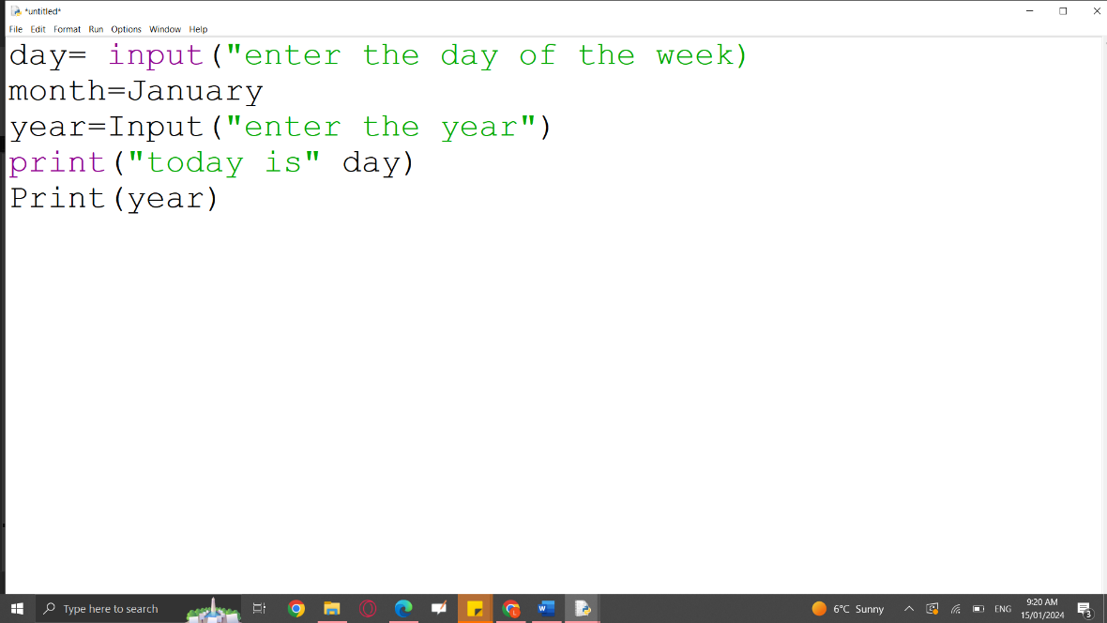
Program errors practice question

Slide 35
Solution
day=input(“enter the day of the week”)
month=“January”
year=input(“enter the year”)
print(“today is”,day)
print(year)

Slide 36
Color codes of python commands
print/input is in purple.
Variable is in black.
String is in green.
Error is in red.
Output is in blue.

Slide 37
INPUT/OUTPUT PYTHON notebook work
The students will do the following questions in their notebooks:
Ask the user to enter email. Display your email is <email>. Ask the user to enter password, ask user to please confirm your password. Display account created successfully.
Ask the user to enter his first name, ask user to enter his last name. Display hello! <first name><last name>.
Ask the user “what question should I ask?” Ask the question the user entered from the user. Display your answer is <answer>

Slide 38
Solutions of the notebook work
email=input(“enter email”)
print(“your email is”,email)
password1=input(“enter your password”)
password2=input(“confirm your password”)
print(“account created successfully”)
2. First_name=input(“enter first name”)
Last_name=input(“ enter last name”)
print(“hello”,First_name, Last_name)
3. question=input(“what question should I ask the user?”)
answer=input(question)
print(“your answer is”,answer)

Slide 39
Conversion from string data type to integer data type lecture notes
For example
Enter a number and convert it into an integer value.
Solution :
number=input(“enter a number”)
number=int(number)

Slide 40
Conversion from string data type to float data type
For example
Enter a number and convert it into a float value.
Solution :
number=input(“enter a number”)
number=float(number)

Slide 41
Conversion practice question
Create a program that sets the value of 2 variables number1 and number 2 as 80 and 90. Add the 2 numbers and then display “the answer is” <answer>.
Num1=input(“enter a number?”)
Num2=input(“enter a number?”)
answer=Num1+Num2
print(“the answer is”, answer)
The answer that will be displayed according to the above program will not be correct. The above program won’t add the 2 numbers but it will join them together. This is because the command input stores values in the string data type and string data types cannot be added.
To add change the data type to int or float the python functions int() and float() can be used.
The same program will be edited with some changes and then executed.
Num1=input(“enter a number?”)
Num1=80
Num2=input(“enter a number?”)
Num2=90
answer=Num1+Num2
print(“the answer is”, answer)

Slide 42
Lab task
1: Ask the user to enter email and assign value “qalbeen@yahoo.com”. Display your email is <email>. Ask the user to enter password and assign value”ABCD”, ask user to please confirm your password. Display account created successfully.
email=input(“enter email”)
email=“qalbeen@yahoo.com”
print(“your email is”,email)
password1=input(“enter your password”)
password1=“ABCD”
password2=input(“confirm your password”)
print(“account created successfully”)

Slide 43
Lab task
2. Ask the user to enter the first name and asign qalbeen to it, ask user to enter the last name and assign khalid to it. Display hello! <first name><last name>.
First_name=input(“enter first name”)
First _name=“qalbeen”
Last_name=input(“ enter last name”)
Last _name=“khalid”
print(“hello”,First_name, Last_name)

Slide 44
Lab task
Create a program of three variables num1 ,num2 and num3 having values 60, 40 and 100. Find the addition of first two numbers and subtract the third number. Display “the answer is “ <answer>
num1=input(“enter a number”)
num1=60
num2=input(“enter a number”)
num2=40
num3=input(“enter a number”)
num3=100
Answer=num1+num2-num3
print(“the answer is”, Answer)

Slide 45
Conversion questions C.W
Create a program that asks the user to enter 2 numbers. Multiply the first number by 5 and display the answer. Divide the second number by 2 and display the answer.
solution:
num1=input(“enter a number”)
num1=int(num1)
num2=input(“enter another number”)
num2=int(num2)
ans1=num1*5
print(“the answer is”,ans1)
ans2=num2/2
print(“the second answer is”,ans2)

Slide 46
Conversion questions C.W
2. Create a program that asks the user to enter 2 numbers. Multiply the numbers and display the answer in the form “the answer is” <answer>.
Solution :
num1=input(“enter a number”)
num1=int(num1)
num2=input(“enter another number”)
num2=int(num2)
answer=num1*num2
print(“the answer is”,answer)

Slide 47
Conversion questions C.W
3. Create a program that asks the user to enter length and width. Calculate the area and display the answer in the form “the area is” <area>.
Solution :
length=input(“enter length”)
width=input(“enter width”)
length=int(length)
width=int(width)
area=length*width
print(“ the area is”,area)

Slide 48
Conversion questions C.W
4. Create a program that asks the user to enter a number. Multiply the number by 20 and subtract 100. Display the answer in the form “the answer is”, <answer>.
Solution :
num1=input(“enter a number”)
num1=int(num1)
answer=num1*20-100
print(“the answer is”,answer)

Slide 49
Conversion questions C.W
5. Create a program that asks the user to enter 2 numbers. Divide the first number by the second number. Display the answer in the form “answer of dividing no1 by no2 is” <answer>.
Solution :
num1=input(“enter a number”)
num1=int(num1)
num2=input(“enter another number”)
num2=int(num2)
answer=num1/num2
print(“answer of dividing num1 by num2 is”,answer)

Slide 50
Lab task
1:Create a program that asks the user to enter 2 numbers having value 60 and 75. Multiply the numbers and display the answer in the form “the answer is” <answer>.

Slide 51
SOLUTION
num1=input(“enter a number”)
num1=60
num2=input(“enter another number”)
num2=75
answer=num1*num2
print(“the answer is”,answer)

Slide 52
Lab task
2:. Create a program that asks the user to enter a number having a value of 10. Multiply the number by 20 and subtract 100. Display the answer in the form “the answer is”, <answer>.

Slide 53
SOLUTION
num1=input(“enter a number”)
num1=10
answer=num1*20-100
print(“the answer is”,answer)

Slide 54
Warm up question LECTURE NOTES
User enters radius assign it the value 50. Calculate area using the formula πr² π=3.14. Display “the area of circle is” <area>.

Slide 55
Plan of action
The operator for division is /.
% is the remainder or modulus operator. This operator returns the number left over when a number is divided by another number. For example, 5%4 = 1.
10%2, 14%3, 20%7, 18%3, 24%3

Slide 56
Plan of action
Machine code is another name for binary code. It is made up of numbers only. A human cannot understand it nor write it.
Executable file is a file made up of machine code which contains commands the computer can execute (carry out).
Programmers use programming languages to write commands. Commands written in a programming language is known as source code.
A computer cannot understand the source code so it must be converted into machine code this process is called translating.
Compiling is the process of turning a program into an executable file. Compiler is the software that converts a program into an executable file.
Interpreting is translating source code into machine code.

Slide 57
Test
Create a program that ask the user to enter 3 numbers. Assign them values 40,25 and 50. Multiply the first two numbers and subtract the third one. Display the answer.
Create a program that asks the user to enter a number. Assign it a value 150. Multiply the number by 10 and subtract 1000. Display the result.
Create a program that asks the user to enter two numbers. Assign them values 100 and 500. Multiply the numbers . Display the solution.

Slide 58
Test
4. User enters 2 numbers having values 60 and 70. Add the numbers and display the answer as “ the answer is” <answer>.
5. User enters 4 numbers, assign them values 10,30,50 and 40. Multiply the first two numbers and display the answer. Subtract the fourth number by third number and display the result.

Slide 59
Test solutions Q#1
num1=input(“enter a number”)
num1=40
num2=input(“enter another number”)
num2=25
num3=input(“enter another number”)
num3=50
answer=num1*num2-num3
print(“the answer is”,answer)

Slide 60
Test Q#2 SOLUTION
num=input(“enter a number”)
num=150
result=num1*10-1000
print(“the result is”,result)

Slide 61
Test Q#3 solution
num1=input(“enter a number”)
num1=100
num2=input(“enter another number”)
num2=50
solution=num1*num2
print(“the solution is", solution)

Slide 62
Test Q#4 solution
num1=input(“enter a number”)
num1=60
num2=input(“enter another number”)
num2=70
answer=num1*num2
print(“the answer is”,answer)

Slide 63
Test Q#5 solution
num1=input(“enter a number”)
num1=10
num2=input(“enter another number”)
num2=30
num3=input(“enter another number”)
num3=50
num4=input(“enter another number”)
num4=40
answer=num1*num2
print(“the answer is”,answer)
result=num3-num4
print(“the result is”,result)

